Slide 1


TrainVago
Railway Administrator System

Slide 2
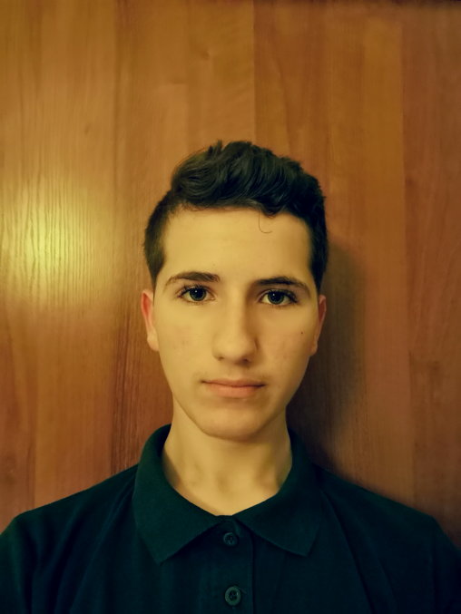



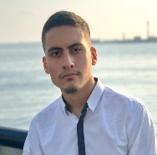

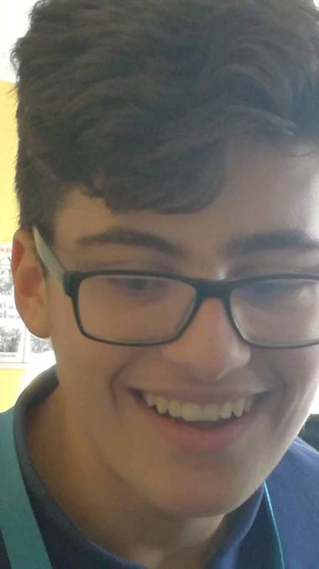


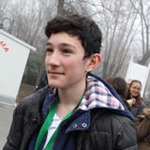

Name: Dani Dimov
Email: DSDimov18@codingburgas.bg
Name: Atanas Burmov
Email: AABurmov18@codingburgas.bg
Name: Kristian Lalev
Email: KALalev18@codingburgas.bg
Name: Kristian Milanov
Email: KAMilnaov18@codingburgas.bg

Slide 3
Idea

Slide 4


Coding

Slide 5
The Future of TrainVago

